Slide 1



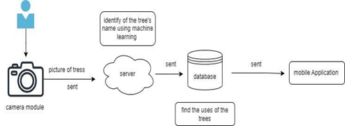




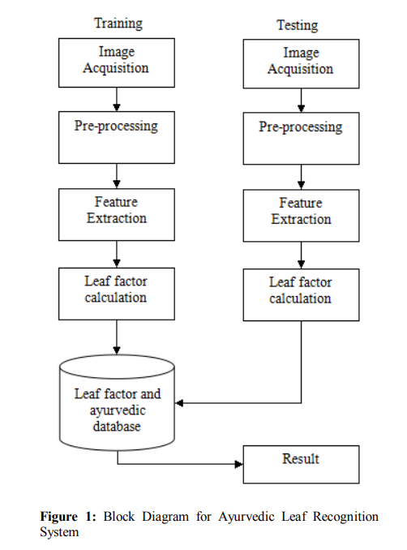
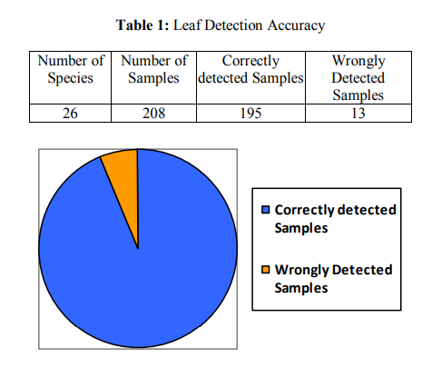
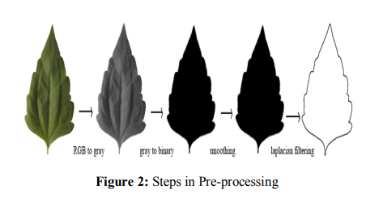

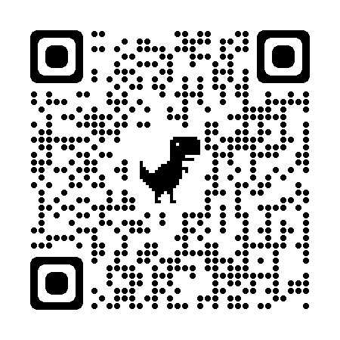
IoT Based Plant Detection and Finding Ayurvedic Plant’s Through Image Processing Zaber Al Mamun, Toufikul Islam Eyasin, MD Abdullah Bin Asad Siam, Sejuti Rahman Fammi
The paper propose the use of internet things (IOT) technology in Plant Based Medicine Alternative system.
The paper presents a Plant Based Medicine Alternative system based on IOT which includes sensor hubs for collecting data ,data analysis ,data processing and plant nidifications.
Mainly the proposed system, with the wireless video and image transmission robot for surveillance systems able to accurately detect and track objects, move within a specific area.
It might be necessary to preprocess the data collect by the robot sensor before it can be analyze .
The captured image is correctly sent to the server.
It will compare the captured image with the image on the server.
It will check what kind of medicine can be made from plants.
Fig: Block diagram of the overall proposed system
RELATED WORKS
ESP32-CAM Camera Module , FM Radio Transmitter , Wheel Drive, 2200mAh Li-Po Battery , Buck Module, 1000uF 16V Capacitor , Lipo battery connector , Power Supply .
Kadir, A., Nugroho, L.E., Susanto, A. and Santosa, P.I., 2013. Leaf classification using shape, color, and texture features. arXiv preprint arXiv:1401.4447 . [Google Scholar] [CrossRef]
Spy Robot Surveillance System using IoT Apsara G*1, Amrithha D*1, Ramya R*1, Mrs. R. Chitra*2. [Google Scholar] [CrossRef]
"Design and Simulation of a Wireless Image Transmission System for Unmanned Aerial Vehicles" by H. Xu, Y. Huang, and J. Zhang. IEEE Access, vol. 7, 2023 . [Google Scholar] [CrossRef]
Shidujaman, M., Samani, H., & Arif, M. (2014, May). Wireless power transmission trends. In Informatics, Electronics & Vision (ICIEV), 2014 International Conference on (pp. 1-6). IEEE. [Google Scholar] [CrossRef]
Shidujaman, M., Rodriguez, L. T., & Samani, H. (2015, June). Design and navigation prospective for wireless power transmission robot. In Informatics, Electronics & Vision (ICIEV), 2015 International Conference on (pp. 1-6). IEEE.. [Google Scholar] [CrossRef]
This paper present video, picture, and image transmission through visible light communication. The device design is comprehensive, and the experimental findings are described and explained in detail. It has been demonstrated that high- quality video/picture and picture transmission . can be accomplished over a distance of 12 feet, with improvements possible by adding a focusing lens between the transmitter and the receiver. Although limitation still exist by comparing images before and after transmission. It is demonstrated that high-quality wireless optical transmission can be accomplished using LEDs. The measurement setup and results have also been presented. We obtain 100% successful result of transmitted image, picture, video, and text file.
For details, please scan:

